Slide 1


STUDY ON BEHAVIOR OF FLOODING AND UNEXPECTED DROUGHT LIKE SITUATION IN GARO HILLS DISTRICT OF MEGHALAYA
APPROVED PDS PROPOSAL
  Lead Research Institution : Water Resources Department, Meghalaya.
  Partner Institution : National Institute of Hydrology
PI - Lead Organization
Er. D. B. Syngkon, Superintending Engineer,
Water Resources Department, Meghalaya.
PI -PARTNER ORGANIZATION
Dr. Sanjay Kumar Sharma, Scientist -‘C’,
National Institute of Hydrology, Guwahati
PROJECT DURATION- 3 YEARS
Cost of Project : Rs. 40,00,000.00
VIth R & D Session Under NATIONAL HYDROLOGY PROJECT

Slide 2
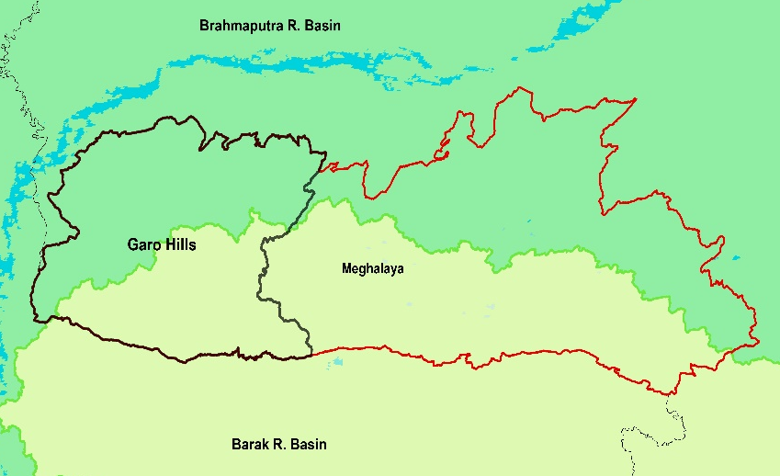
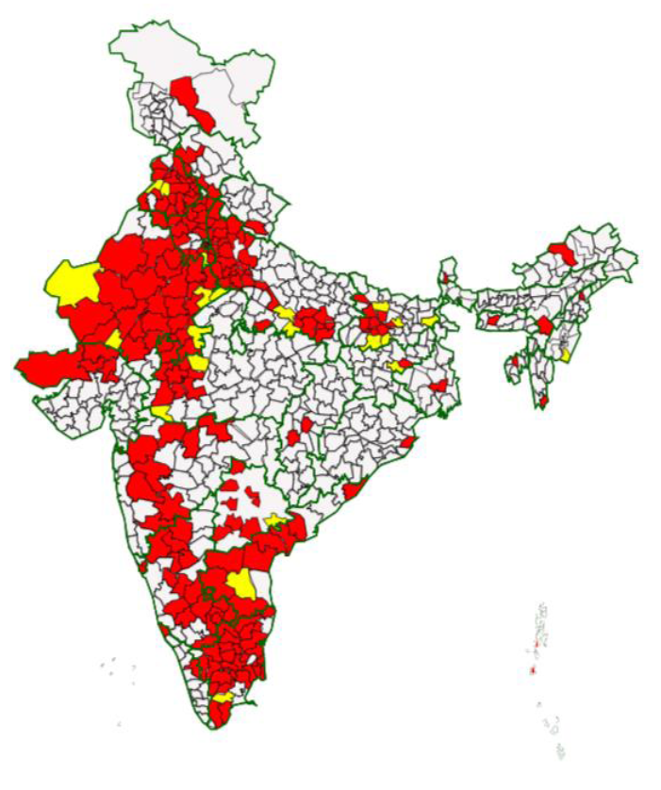
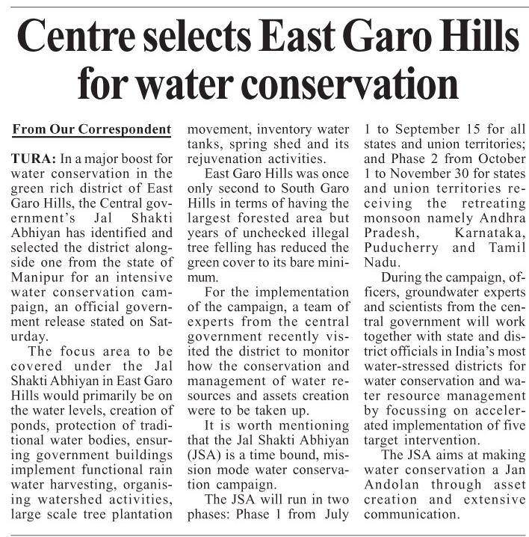
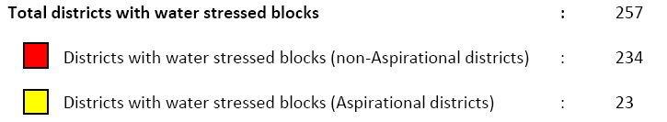
Jal - Sakthi Abhiyan Concept Note Released on 26-06-2019

Slide 3
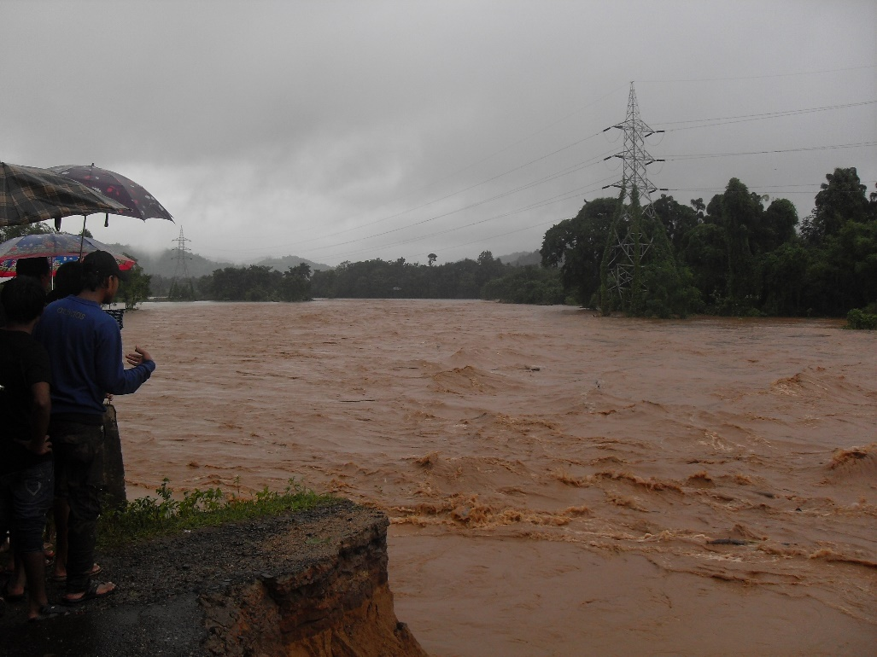
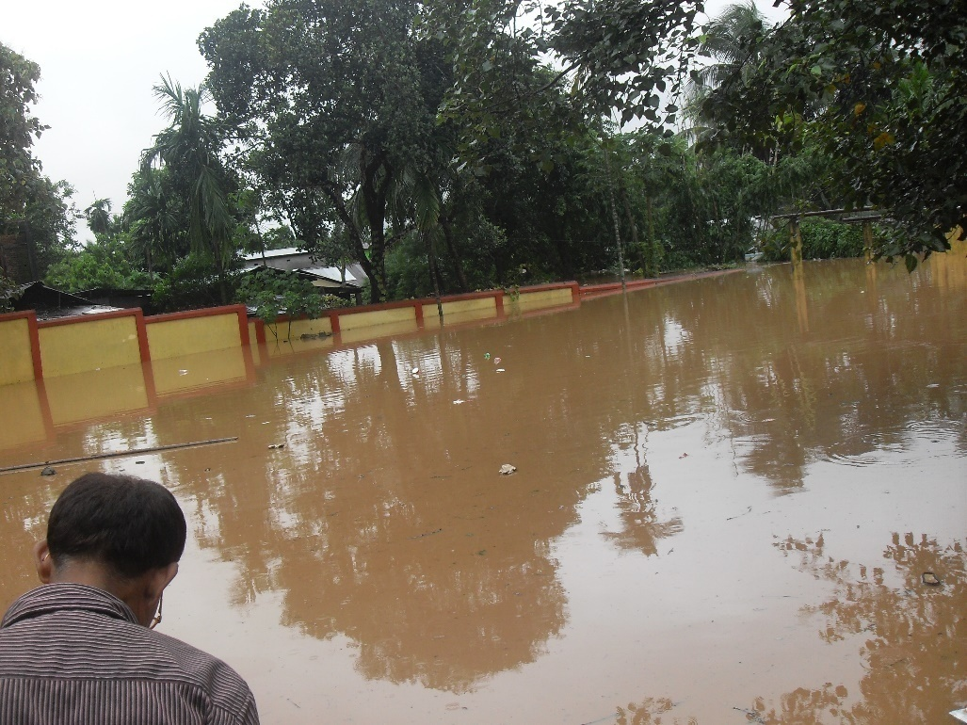

Slide 4
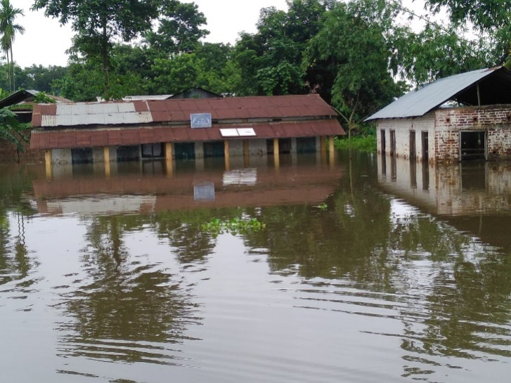
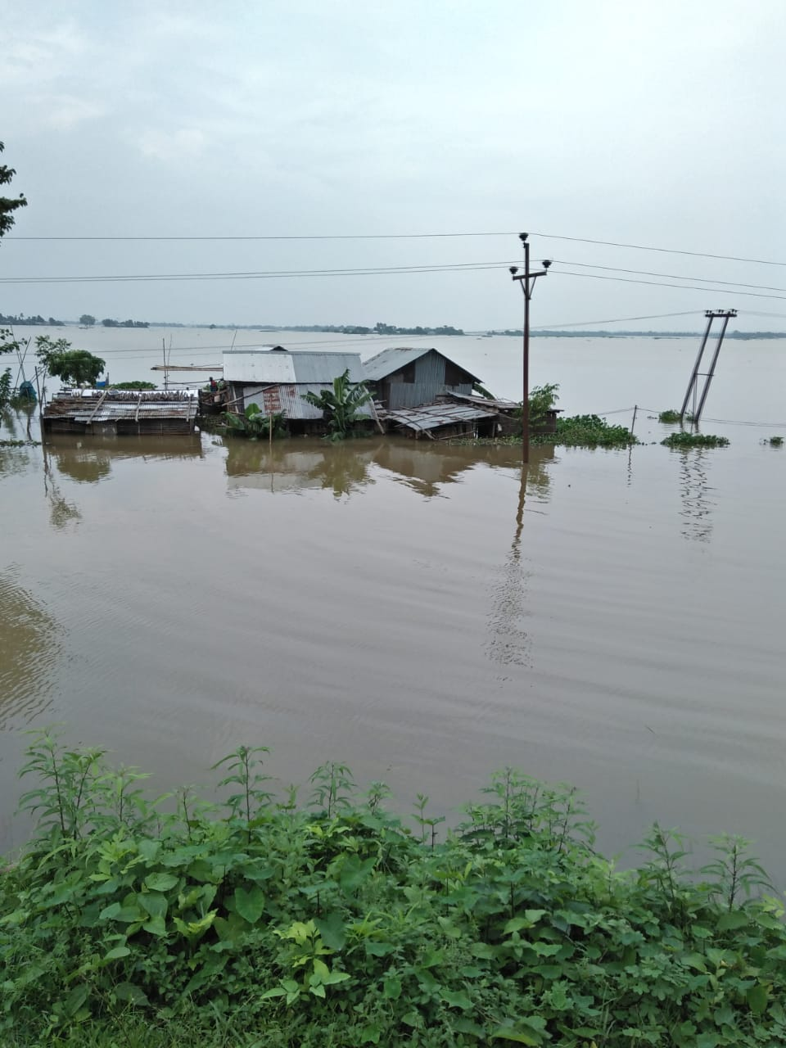
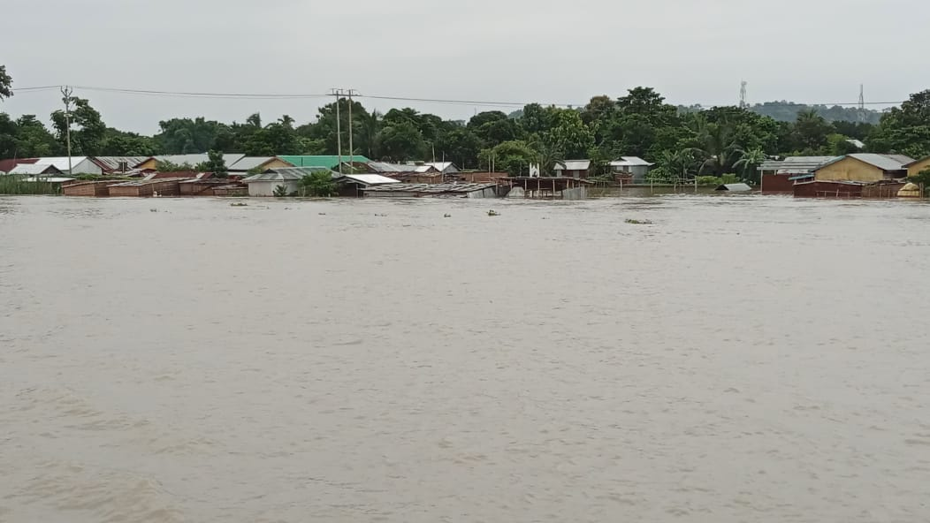
Photos & Information are Collected by the Project PI of Lead Agency

Slide 5
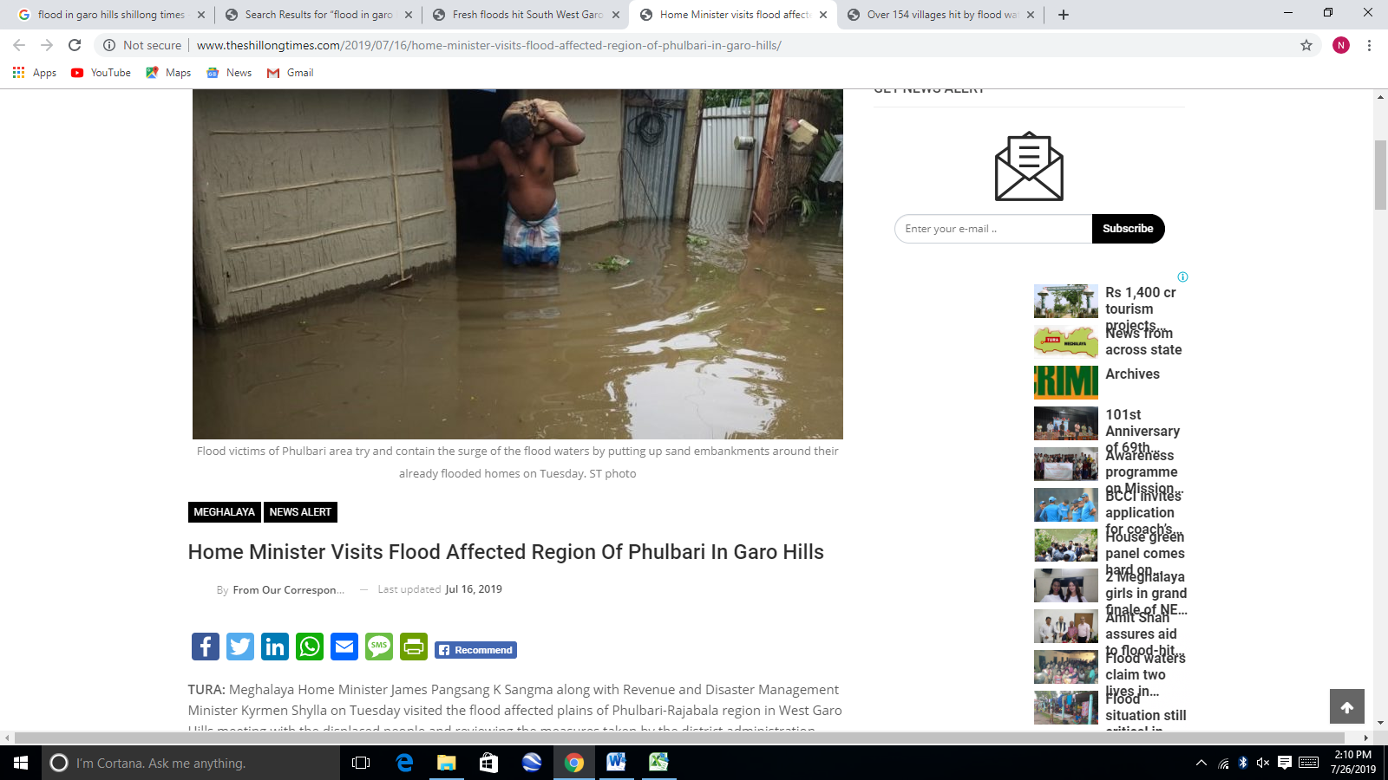
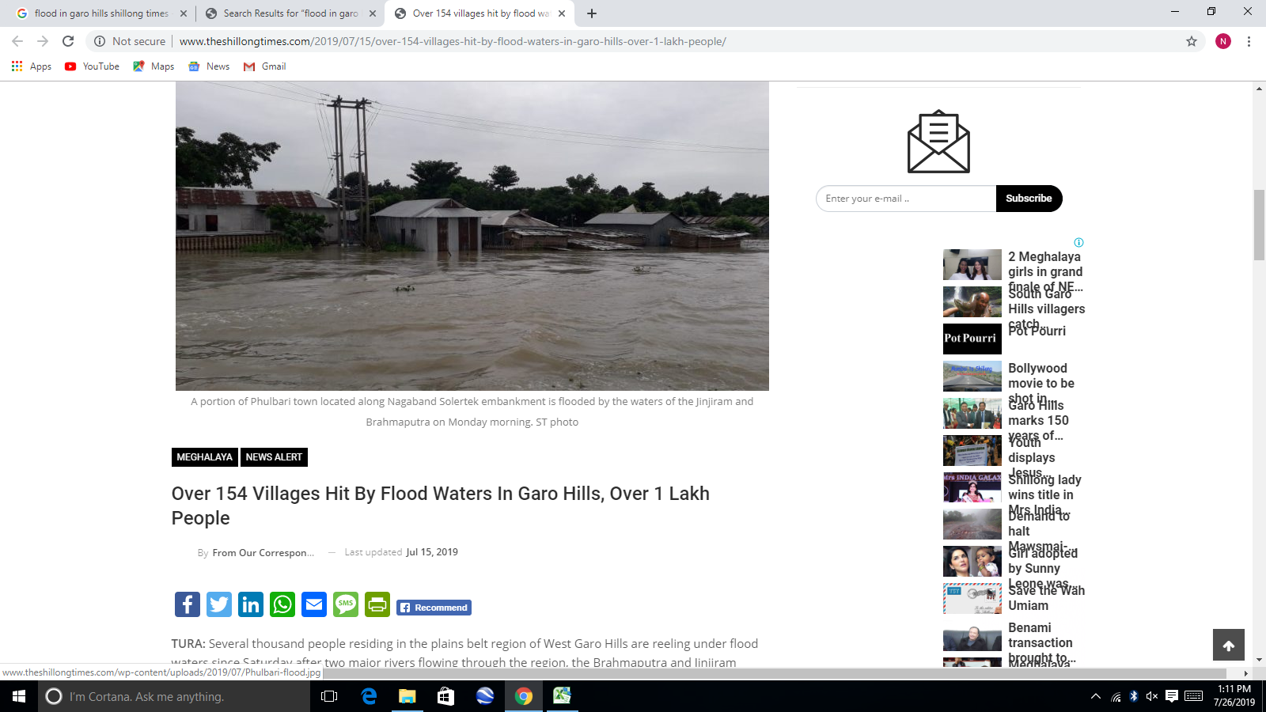

Slide 6
Review of Literature
Jain et al (2013) | Analyzed the rainfall and temperature trends in Northeast India from 1871-2008. They found seasonal trends for some hydrometerological subdivisions for rainfall and reported rising trends for temperature variables
Ray et al (2013) | Rainfall analysis was carried out based on thirty five years (1973-2007) daily rainfall data in Shillong, Meghalaya. They reported an incident of severe drought in the year 2000; eight years with moderate and eleven years with mild drought at Shillong.
Parida and Oinam (2015) | Analyzed the percentage departure of rainfall for two decade (1997-2014) found that SW rainfall in North Eastern region has gradually dropped in recent years compared to 1980s and 1990s resulting in witnessing of frequent unprecedented drought in North East, India. They reported that in North East India, probability of drought occurrence was 54%, compared to 27% for Western India in the recent decade (2000–2014).
STUDY ON BEHAVIOR OF FLOODING AND UNEXPECTED DROUGHT LIKE SITUATION IN GARO HILLS DISTRICT OF MEGHALAYA

Slide 7
Review of Literature
CFMSG, NIH (1997) | Undertook a study on Flood Plain Mapping of Phulbari Area in Meghalaya. The study mapped the flood plain of the area with the remote sensing data, IRS-1A & 1B at 1:50000 FCC were used.
Sharma et al (2018) | Analyzed the hydrological sensitivity for flood risk assessment forKulsi River basin, Brahmaputra (Assam/Meghalaya). Rainfall-Runoff-Inundation (RRI) hydrological model was used to simulate the recent historical flood. They found that calibrated and validated RRI model simulations agreed well with the observed discharge and (MODIS)-detected flood extents.
Barman et al (2019) | Developed a Flood Early Warning System (FLEWS) in Brahamaputra and Barak Valleys based on hydrometerological inputs. The model has been extended to Arunachal Pradesh, Manipur, Tripura and Nagaland in North East India
STUDY ON BEHAVIOR OF FLOODING AND UNEXPECTED DROUGHT LIKE SITUATION IN GARO HILLS DISTRICT OF MEGHALAYA

Slide 8
Objectives
Based on the research problem following research objectives have been framed
1 | To assess Land use and Land cover change for the past two decades (2000-2020) in Garo Hills.
2 | To assess the frequency of occurrence and severity of drought and dry spells in Garo Hills.
3 | To identify areas vulnerable to drought risk in Garo Hills using physical social and climatic factors including satellite rainfall data and other thematic information.
4 | To carryout flood frequency analysis and to map the flood inundated areas in Garo Hills using Rainfall-Runoff-Inundation (RRI model).
5 | To prepare region specific plan for drought mitigation and flood management in Garo Hills.
STUDY ON BEHAVIOR OF FLOODING AND UNEXPECTED DROUGHT LIKE SITUATION IN GARO HILLS DISTRICT OF MEGHALAYA

Slide 9
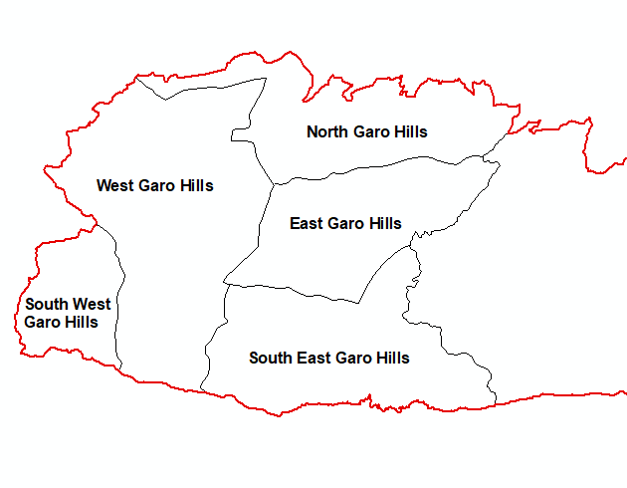
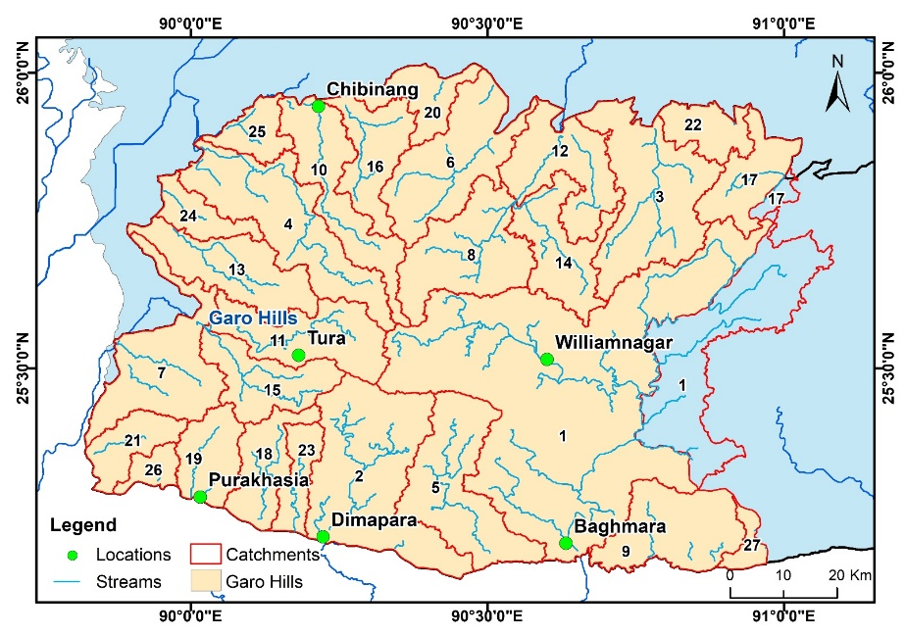
Study Area
The Garo Hills are low lying areas of Meghalaya whose altitude ranges from 20 to 1420 m above mean sea level with an average elevation of 350 m.
Administrative jurisdictions in the region are namely West, South - West, North, East & South Garo Hills and total area is 9715.85 Km².
Annual rainfall of Garo Hills ranges from 2500 to 4000 mm
Northern part of Garo Hills flow into Brahmaputra River and few main tributaries are Dudhnoi, Krishnai, Jinary, Ringgi Chibima, Galwang Chibima, Kala & Gangol.
Southern part of Garo hills flow into Barak Basin entering Bangladesh and few main tributaries are Simsang also known as Someshwari, Bugi or Bhugai and Dareng are the main tributaries.
STUDY ON BEHAVIOR OF FLOODING AND UNEXPECTED DROUGHT LIKE SITUATION IN GARO HILLS DISTRICT OF MEGHALAYA

Slide 10
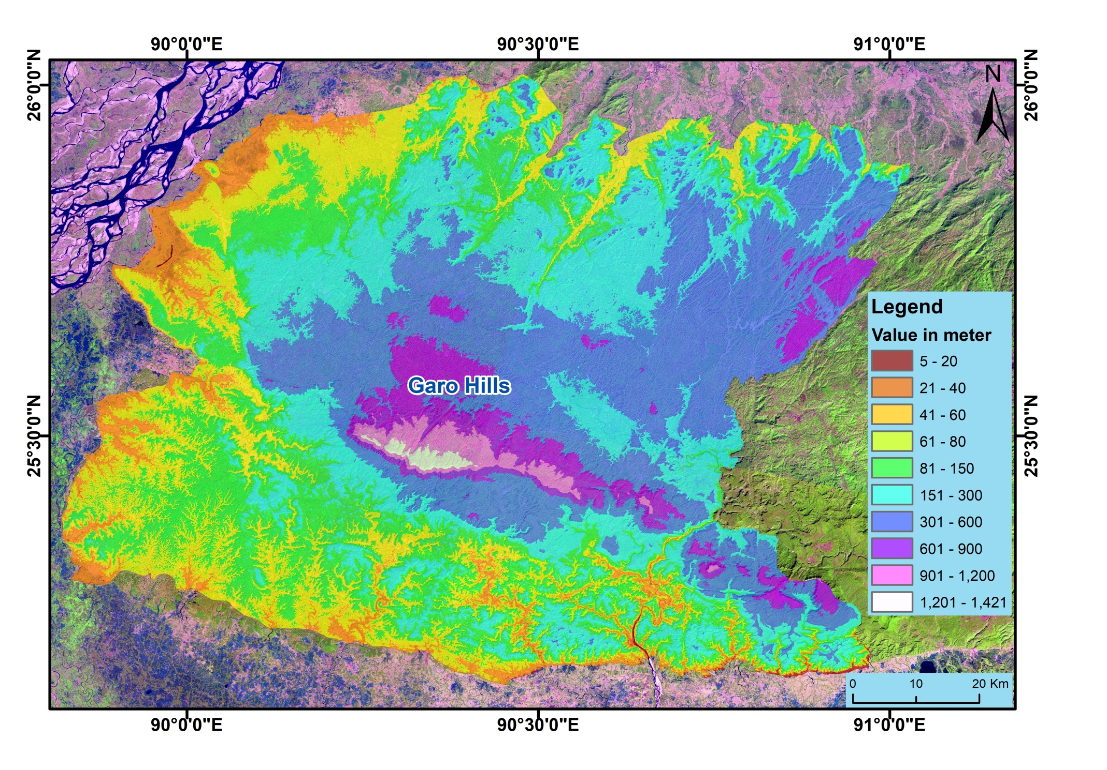
DEM of GARO HILLS

Slide 11
Methodology
Satellite Data collection through Open source portals like USGS Earth Explorer & Sentinel Science Data Hub, ordering of Required scenes of IRS Resourcesat 2, LISS-III & LISS-IV satellite Images from ISRO
Landuse & Landcover change using Geospatial tools for demarcating Drought Affected Areas using state of art Earth observing Satellite Image products.
Bias Correction and Analysis of Satellite precipitation data using observed rainfall data for Assessment of Drought and Flood Inundation Modelling RRI-(Hydrological Model –Rainfall Runoff Inundation).
Spatially distributed Meteorological Drought assessment would be carried out using Standard Precipitation Index and rainfall departure analysis over Garo hills.
Spatially Distributed Hydrological Rainfall Runoff modelling using Rainfall Runoff Inundation modelling for Flood Inundation & Forecasting.

Slide 12
Flowchart of Methodology
Hydrology & Flood
Remote Sensing & GIS
Rainfall & Discharge Data
Meteorology & Drought
Drainage Delineation
Outlet Identification
Delineation of Catchments
Flood Inundation Modelling
SRTM & ASTER DEM
Landsat 7 & 8 Data
Sentinel 1 & 2 Data
IRS Resourcesat 2 data
CWC Discharge Data
IMD Rainfall Data
TRMM & GPM Data
Rainfall & Waterlevel Recorder via PDS
Rainfall Departure Analysis
Standard Precipitation Index (SPI)
Drought Vulnerability Index (DVI)
Rainfall Runoff Inundation - Flood Inundation Modelling for the Catchments in the Garo hills Districts
Assessment of Landuse & Landcover change & Correlations with Drought Indices to demarcate drought affected areas
1. Maps showing landuse & landcover change
2. Maps demarcating area prone for drought risk.
3. Flood inundation maps & flood forecasting strategies
4. Project Report of Water Resources Status, Planning & Management of Water in Garo Hills
Societal Need/Benefits
Catchment wise analysis for decision making and implementation of irrigation and water resources management plan by stakeholders in region
STUDY ON BEHAVIOR OF FLOODING AND UNEXPECTED DROUGHT LIKE SITUATION IN GARO HILLS DISTRICT OF MEGHALAYA

Slide 13
Assessment of Land use and Land cover change
Assessment of Drought through Landuse & Landcover change derived during 2000 – 2020 on decadal basis.
Landuse & landcover maps will be generated as per National Urban Information System (NUIS) standards 2008.
Scale of maps will be 1:25,000 & 1:50,000 using datasets of different resolutions from 5.8 m to 30 m.
S. No | Satellite | Sensor | Resolution (in Meter) | Scale of Map | Available Duration
1 | Landsat 5 | TM | 30 | 1:50,000 | March 1984 to Dec 2012
2 | Landsat 7 | ETM+ | 15, 30 | 1:50,000 | April 1999 to May 2003
3 | Landsat 8 | OLI/TIRS | 15, 30 | 1:50,000 | March 2013 to Present
4 | Resoursesat 2, 2A | LISS-III, LISS-IV Mx | 23.5, 5.8 | 1:50,000 1:25,000 | October 2011 to Present
USGS Earth Explorer ( DEM & Landsat Data) : https://earthexplorer.usgs.gov/
Sentinel Science Data Hub (Sentinel 1 & 2 Data) : https://scihub.copernicus.eu/dhus/#/home
NRSC Data (Resoursesat1 Liss –III & IV) : https://uops.nrsc.gov.in/
STUDY ON BEHAVIOR OF FLOODING AND UNEXPECTED DROUGHT LIKE SITUATION IN GARO HILLS DISTRICT OF MEGHALAYA

Slide 14
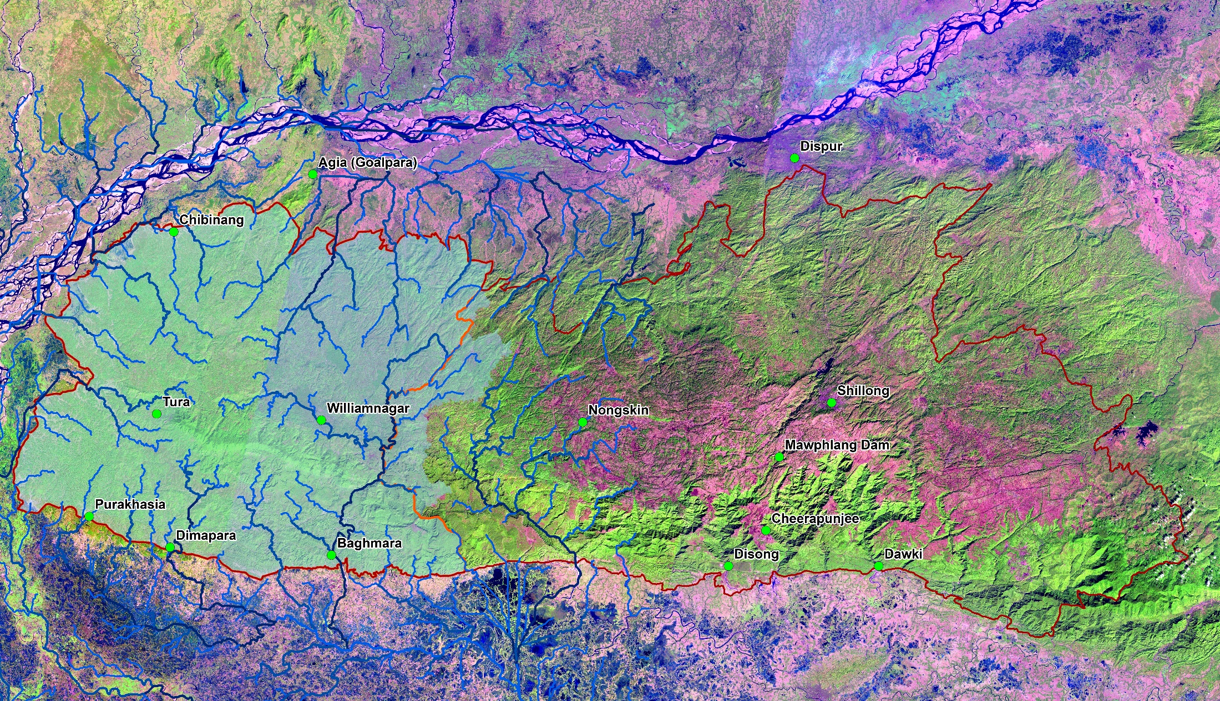
Satellite Image Database of Meghalaya – CFMSG Data Repository
STUDY ON BEHAVIOR OF FLOODING AND UNEXPECTED DROUGHT LIKE SITUATION IN GARO HILLS DISTRICT OF MEGHALAYA

Slide 15
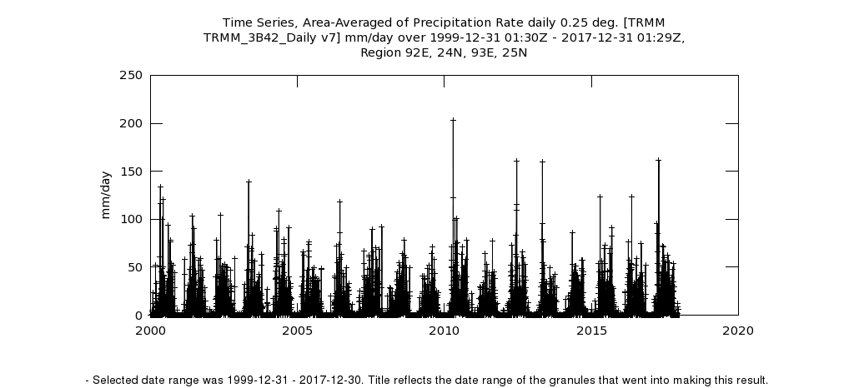
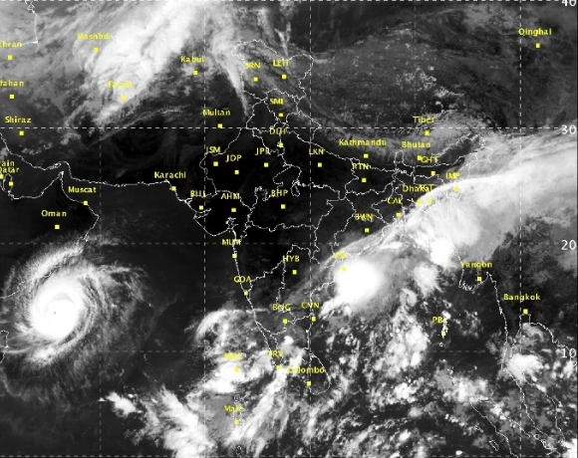
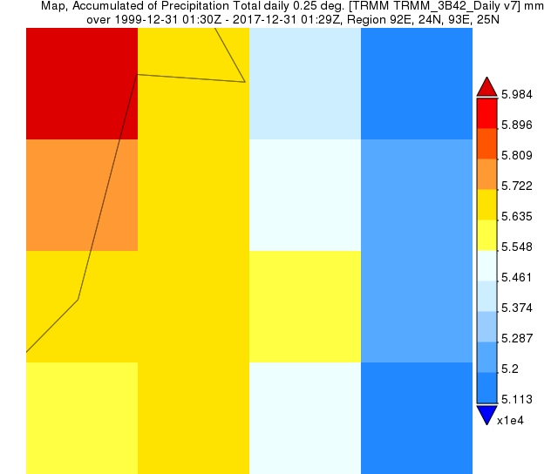
Analysis of Satellite Rainfall Products
TRMM Daily product 3B42 RT version 7 for the period 2000-2017, near-global (50°N to 50°S) precipitation product having a spatial resolution of 0.25° will be used.
Satellite precipitation products (TRMM 3B42-RT and GPM IMERG ) will be corrected with observed rainfall.
Precipitation products will be for runoff calculation using Hydrological Rainfall Runoff Inundation Model
IMD - INSAT, TRMM & GPM based Satellite based rainfall products & Plots are shown below showing monsoonal circulation & Precipitation occurrences
NASA Satellite Precipitation data link: https://pmm.nasa.gov/
STUDY ON BEHAVIOR OF FLOODING AND UNEXPECTED DROUGHT LIKE SITUATION IN GARO HILLS DISTRICT OF MEGHALAYA

Slide 16
Drought Assessment
Daily rainfall data from raingauges in and around the study area will be collected for period spanning from 2000-2020.
IMD’s Gridded precipitation data (0.25° x 0.25°), TRMM 3B42 V7 (0.25° x 0.25°) & GPM IMERG V05 (0.1° x 0.1°) Satellite precipitation datasets will also be used for assessment of Meteorological Drought.
The assessment frequency and severity of meteorological drought events will be carried out using rainfall departure analysis.
Rainfall Departure Analysis & Standardized Precipitation Index (SPI) will be used for drought monitoring and analysis.
The weights of the vulnerability factors will be integrated to form a drought vulnerability index (DVI) and areas vulnerable to drought both spatially and temporally will be demarcated.
STUDY ON BEHAVIOR OF FLOODING AND UNEXPECTED DROUGHT LIKE SITUATION IN GARO HILLS DISTRICT OF MEGHALAYA

Slide 17
Rainfall Departure Analysis
The computation of Rainfall Departure involves the following steps:
The evaluation of meteorological drought severity will be carried out by employing IMD method.
The drought years will be identified based on the departure analysis of annual and seasonal rainfall for the study period.
The annual or seasonal rainfall departure will be calculated by subtracting the mean of annual or seasonal rainfall (R_{m}) from the annual or seasonal rainfall (R_{i}) for that year respectively.
The percentage departure (D_{i}) will be computed by dividing the mean rainfall for the station by the rainfall departure as given by the equation, D_{i}(%)= [(R_{i}-R_{m})/R_{m}]*100
STUDY ON BEHAVIOR OF FLOODING AND UNEXPECTED DROUGHT LIKE SITUATION IN GARO HILLS DISTRICT OF MEGHALAYA

Slide 18
Standardized Precipitation Index (SPI)
The computation of the SPI involves the following steps:
Calculation of mean of the normalized precipitation of the log-normal (ln) rainfall series;
Fitting a two-parameter gamma probability density function to a given frequency distribution of the precipitation;
Computation of shape and scale parameters β and α respectively for each time scale of interest
The computation of SPI requires continuous long-term data of monthly precipitation for at least 20 years.
The classification of drought severity is based on the SPI range; if the SPI value lies between –1.00 and –1.49, it indicates moderate drought situation; similarly the SPI range between –1.50 and –1.99, denotes severe drought condition and the SPI value less than –2.00, leads to an extreme drought state.
STUDY ON BEHAVIOR OF FLOODING AND UNEXPECTED DROUGHT LIKE SITUATION IN GARO HILLS DISTRICT OF MEGHALAYA

Slide 19
Drought Vulnerability Index (DVI)
The multiple factors include topographic features of the basin, soil type, land use land cover pattern, rainfall departure and stream flow availability.
Each drought indicator is grouped into several subclasses based on its exposure to drought and a numerical weight varying between 0 and 5 is assigned to each subclass.
lower weight (0) indicates less vulnerability to drought and 5 is the most vulnerable condition.
The DVI may be defined as the ratio of the sum of weights of drought vulnerability indicators to the maximum weight of the vulnerability indicator times total number of indicators considered.
The DVI may be described as
N - the number of spatial and temporal factors under consideration
W_{i} - the weights of drought vulnerability indicators (i =1,2,3…5)
k - the maximum value of vulnerability weights
STUDY ON BEHAVIOR OF FLOODING AND UNEXPECTED DROUGHT LIKE SITUATION IN GARO HILLS DISTRICT OF MEGHALAYA

Slide 20
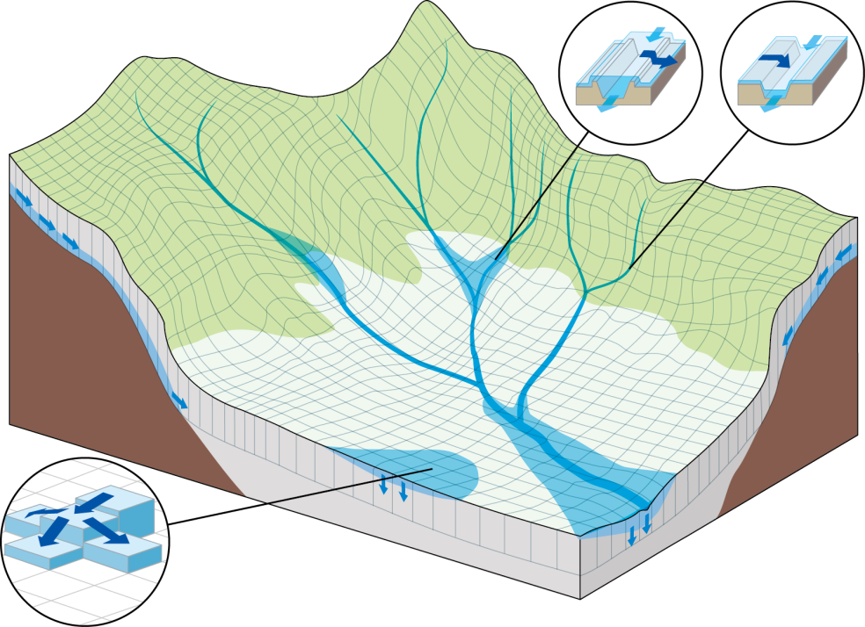
RRI Model
1D Diffusion
in River
Input
Subsurface + Surface
Output
Rainfall
Discharge
DEM
W. Level
Land Cover
Inundation
Cross Sec.
2D Diffusion
in Catchment
Vertical Infiltration
Two-dimensional model capable of simulating rainfall-runoff and flood inundation simultaneously
The model deals with slopes and river channels separately
At a grid cell in which a river channel is located, the model assumes that both slope and river are positioned within the same grid cell
Sayama, T. et al.: Rainfall-Runoff-Inundation Analysis of Pakistan Flood 2010 at the Kabul River Basin,
Hydrological Sciences Journal, 57(2), pp. 298-312, 2012.

Slide 21
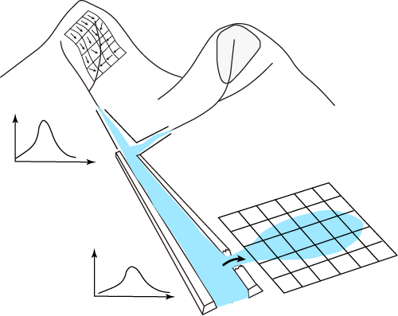
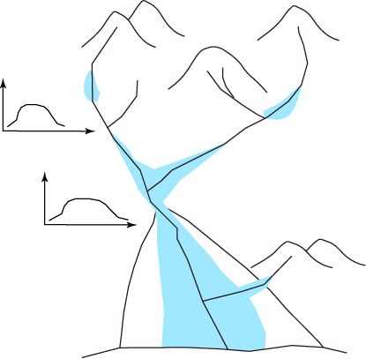
Rainfall-Runoff-Inundation Model
Rainfall-Runoff Model
Flood Inundation Model
River Routing Model
Ordinary Rainfall-Runoff models are incapable of simulating inundation effects.
Flood inundation models are typically designed to be applied only to floodplains with boundary conditions from a breaching point.
Rainfall-runoff and inundation processes should be simulated simultaneously for some cases.
STUDY ON BEHAVIOR OF FLOODING AND UNEXPECTED DROUGHT LIKE SITUATION IN GARO HILLS DISTRICT OF MEGHALAYA

Slide 22
Distributed R-R Model
RRI Model
Flow directions are fixed based on topography
Flow directions change based on water levels
Land
River
STUDY ON BEHAVIOR OF FLOODING AND UNEXPECTED DROUGHT LIKE SITUATION IN GARO HILLS DISTRICT OF MEGHALAYA

Slide 23
Calculation at River Grid Cell
Mass balance
Manning Flow
: Hydraulic gradient
: Roughness on river
STUDY ON BEHAVIOR OF FLOODING AND UNEXPECTED DROUGHT LIKE SITUATION IN GARO HILLS DISTRICT OF MEGHALAYA

Slide 24
WORK PLAN AND ACTIVITY CHART
Assessment of Land use and Land cover change
Sl. No | Activity | Q 1 | Q 2 | Q 3 | Q 4 | Q 5 | Q 6 | Q 7 | Q 8 | Q 9 | Q 10 | Q 11 | Q 12
1 | Collection data including procurement of Satellite data
2 | Pre-processing and analysis of relevant hydro-meteorological data, Satellite Data & Digital database Generation
3. | Satellite Data Analysis and Classification of Landuse & Landcover
4. | Assessment of Landuse & Landcover Change and Validations
5 | Correlations of Landuse & Landcover Change with Meteorological Drought events.
6 | Preparation of drought vulnerability and flood inundation maps.
7 | Ground truething Verification of results
8 | Report preparation
STUDY ON BEHAVIOR OF FLOODING AND UNEXPECTED DROUGHT LIKE SITUATION IN GARO HILLS DISTRICT OF MEGHALAYA

Slide 25
WORK PLAN AND ACTIVITY CHART
Sl.No | Activity | Q1 | Q2 | Q3 | Q4 | Q5 | Q6 | Q7 | Q8 | Q9 | Q10 | Q11 | Q12
1 | Rainfall Data Collection
2 | Downloading of Satellite Rainfall Data
3. | Standard Precipitation Index and Rainfall Anomaly Calculations
4. | Statistical Correlation
5. | Report Writing
Identification of high drought risk areas in Garo Hills
Sl.No | Activity | Q1 | Q2 | Q3 | Q4 | Q5 | Q6 | Q7 | Q8 | Q9 | Q10 | Q11 | Q12
1 | Procurement of Automatic Rainfall & Discharge Instruments
2 | Field visit for Feasibility and site suitability, Installation & Maintenance
3. | Derivation of Model parameters
4. | RRI Modelling for Flood Inundation assessment
5. | Report Writing
Mapping of Flood Inundated areas in Garo Hills
STUDY ON BEHAVIOR OF FLOODING AND UNEXPECTED DROUGHT LIKE SITUATION IN GARO HILLS DISTRICT OF MEGHALAYA

Slide 26
Total Cost of Project : Rs. 40,00,000.00
(approx. and subject to revision)
Total Cost of Project & Head-wise Abstract
S. No. | Head | Amount (Rs. In lakh)
1 | Remuneration/Emoluments for Manpower | 10.50
2 | Travelling Expenditure | 2.50
3 | Infrastructure/Equipment’s | 8.00
 | Sub Total: | 21.00
4 | Contingency | 1.00
 | Total | 22.00
Lead Institution 22.0 (Twenty Two Lakh)
S. No. | Head | Amount (Rs. In lakh)
1 | Workshop and Training | 2.00
2 | Remuneration/Emoluments for Manpower | 10.50
3 | Travelling Expenditure | 2.50
4 | NRSC Data Procurement | 1.00
5 | Hydrometerolgical Data Procurement | 0.50
6 | Contingency/Miscellaneous | 0.50
7 | Workstation | 1.00
 | Total: | 18.00
Partner Institution 18.00 (Eighteen Lakh)
STUDY ON BEHAVIOR OF FLOODING AND UNEXPECTED DROUGHT LIKE SITUATION IN GARO HILLS DISTRICT OF MEGHALAYA

Slide 27
Q1 | Review of literature part in the proposal is missing. Please provide specific review on Flood modelling and drought assessment. Why Rainfall-Runoff-Inundation (RRI) model is selected for the proposed study? What are the other models?
Ans | Review of Literature section for flood modelling and drought assessment have been added in the proposal. RRI model is a free software developed for simultaneous simulation of water levels and inundation area. Other models for flood inundation modelling include HEC HMS, MIKE SHE and HEC RAS. RRI model has been found to perform better for mountainous region and has found to perform better than HEC HMS simulation as reported by one study.
REVIEWER COMMENTS AND REPLY

Slide 28
Q2 | In brief provide the status of flood modelling and drought assessment studies carried out by various researchers for the NE region.
Ans | Status of flood modelling and drought assessment studies for NE region have been included in Review of Literature section.
Q3 | Methodology portion of the proposal is week. Please provide brief methodology both for flood and drought.
Ans | Methodology for flood and drought in the proposed study has been modified as per suggestion
REVIEWER COMMENTS AND REPLY

Slide 29
Q4 | What is the use of AWS data in the proposed study?
Ans | AWS has been changed to Automatic Raingauges 4 Nos for real time rainfall information
Q5 | Who will maintain the AWS?
Ans | The automatic Raingauges will be maintained at each circle office.
REVIEWER COMMENTS AND REPLY

Slide 30
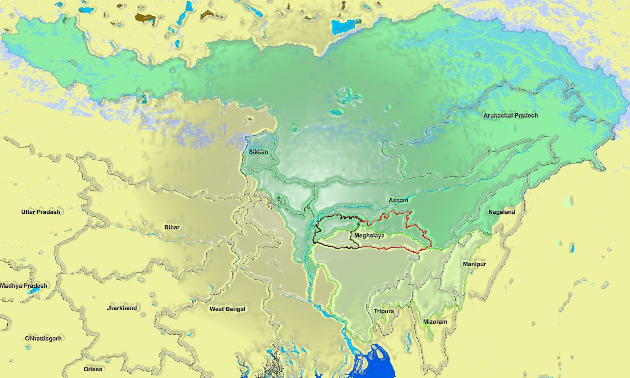
SYNOPTIC VIEW OF BRAHMAPUTRA & BARAK BASIN
Thank you for the opportunity..
Brahmaputra Basin
Brahmaputra R.
Barak Basin
STUDY ON BEHAVIOR OF FLOODING AND UNEXPECTED DROUGHT LIKE SITUATION IN GARO HILLS DISTRICT OF MEGHALAYA

